Slide 1
P2T Labs
Lab Head: Sam Skipsey (he/him;they/them)

Slide 2
Structure
There are 1+6 Labs:
Lab 0: Intro + Signup
Lab 1 – 6:
C Lab component
Linux Lab component
BOTH are required for each lab.
3 Lab Days a week
MON, WED, FRI
Attend the day you selected.
You may log into brutha outside of hours if needed

Slide 3
Remote Teaching
Labs will be coordinated via a Zoom call
This will be the same room as used for Lectures
We will run multiple breakout rooms and distribute students amongst them.
The demonstrator in your breakout room will also be your marker.

Slide 4
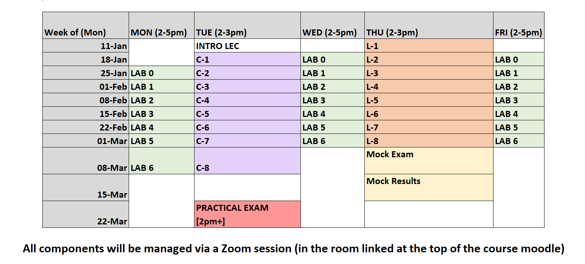

Slide 5
Topics
Lab 1: Variables, Constants, Operators; Intro to Bash
Lab 2: Loops, Conditionals; Process control, Pipes
Lab 3: Arrays, Strings; Intro to scripting
Lab 4: Functions, Pointers; Advanced scripting
Lab 5: C Build workflow, multifile projects; Git, Make (managing projects)
Lab 6: File I/O, PRNGs; GDB (code debugging)

Slide 6
Deadlines
Lab 1 Deadline: 8 Feb 2021
Lab 2 Deadline: 15 Feb 2021
Lab 3 Deadline: 22 Feb 2021
Lab 4 Deadline: 1 Mar 2021
Lab 5 Deadline: 8 Mar 2021
Lab 6 Deadline: 15 Mar 2021
Late submissions will incur penalties every day or part-day, according to the University
Policy. (2 grade points lost per day or part-day)

Slide 7
Marking and Demonstrating
< 10 students per demonstrator
Should be more like 6 or 7
All students are assigned a demonstrator for marking
This demonstrator will always mark your work and moderate your Zoom break-out room.
They will be present on your CHOSEN LAB DAY
They will be assigned on Lab 0
The point of Lab time is for contact time with your demonstrator
You need Practice to learn Programming

Slide 8
Plagiarism and Group Work
You are encouraged to discuss work with others.
With demonstrators present in your Lab.
With other students in your Lab.
Discussing is not the same as copying.
You don’t learn by copying without understanding.
Your submitted work should be entirely your own.
A link to the University Policy on Plagiarism is included in the questionnaire/form you will respond to on Moodle.

Slide 9
Brutha and remote servers
All your Labs will be performed logged into a remote server called brutha.
Brutha is a linux server (hosted currently downstairs in the Kelvin Building)
We will work through how to connect in Lab 0.
(For those interested: we're using a browser-based graphical login server called Guacamole)
You will each have persistent accounts on brutha, and your work will be stored there.
(Submission of labs will be done via Moodle.)

